Slide 1
Markov Decision Processes
HaeJoong Lee
Sogang University, EE
2020.03.05

Slide 2
Markov Decision Processes
Markov Process
Markov Reward Processes
Markov Decision Processes

Slide 3
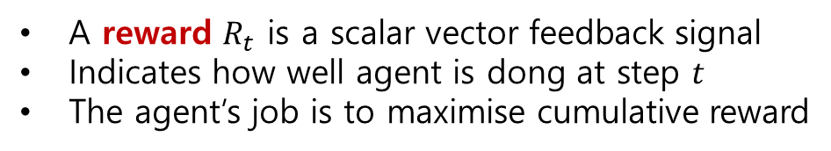
Reward
Rewards
A reward $R_{t}$ is a scalar vector feedback signal
Indicates how well agent is dong at step $t$
The agent’s job is to maximise cumulative reward
Reinforcement learning is based on the reward hypothesis
Definition (Reward Hypothesis)
All goals can be described by the maximisation of expected cumulative reward
Sequential Decision Making
Goal : select actions to maximise total future reward
Actions may have long term sequences
Reward may be delayed
It may be better to sacrifice immediate reward to gain more
long-term reward

Slide 4
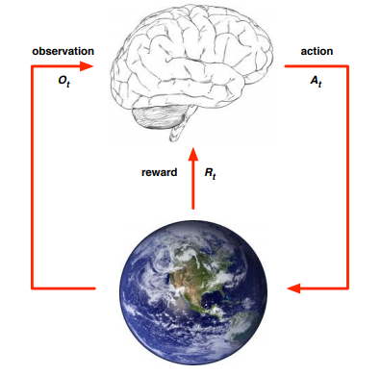
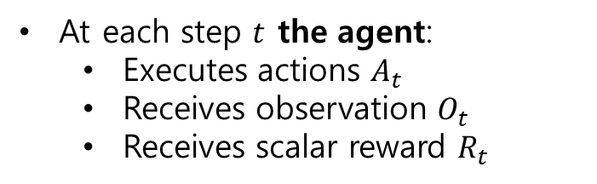

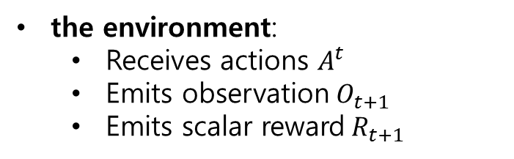
Environments
Agent and Environment
At each step $t$ the agent:
Executes actions $A_{t}$
Receives observation $O_{t}$
Receives scalar reward $R_{t}$
Agent
the environment:
Receives actions $A^{t}$
Emits observation$O_{t+1}$
Emits scalar reward$R_{t+1}$
$t$ increments at env. step
Environments

Slide 5

State
History and State
The history is the sequence of observations, actions, rewards
$H_{t}=$ $O_{1},R_{1},A_{1},O_{2},R_{2},A_{2}, …, A_{t−1},O_{t},R_{t}$
i.e. all observable variables up to time $t$
What happens next depends on the history:
The agent selects actions
The environment selects observations/rewards
State is the information used to determine what happens next
Formally, state is a function of the history:
$$S_{t}=f(H_{t})$$

Slide 6
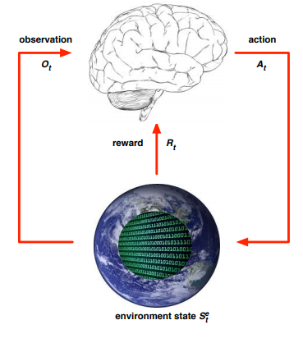
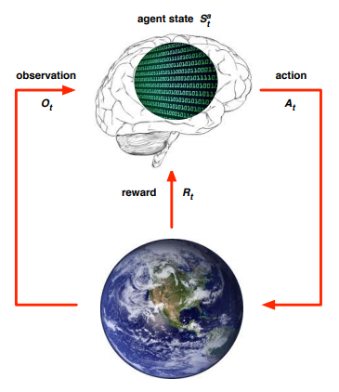

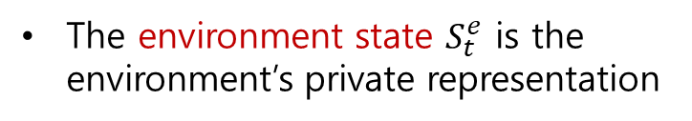
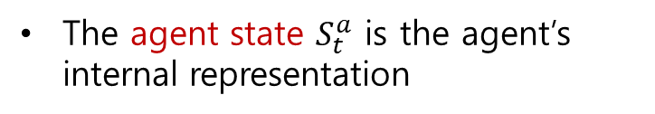
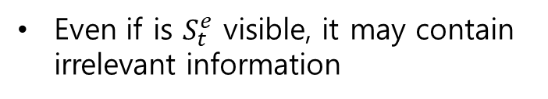
State
Environment State
The environment state $S_{t}^{e}$ is the environment’s private representation
whatever data the environment uses to pick the next observation/reward
The environment state is not usually visible to the agent
Even if is $S_{t}^{e}$ visible, it may contain irrelevant information
Agent State
The agent state $S_{t}^{a}$ is the agent’s internal representation
whatever information the agent uses to pick the next action
it is the information used by reinforcement learning algorithms
It can be any function of history:
$$S_{t}^{a}=f(H_{t})$$

Slide 7

State
Rat Example
What if agent state = last 3 items in sequence?
What if agent state = counts for lights, bells and levers?
What if agent state = complete sequence?

Slide 8
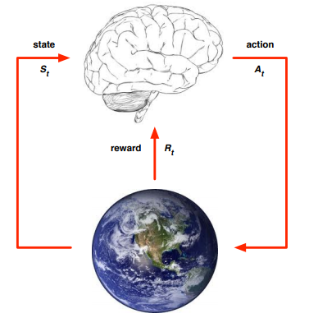

State
Fully Observable Environments
Full observability: agent directly observes environment state
$$O_{t}=S_{t}^{a}=S_{t}^{e}$$
Agent state = environment state = information state
Formally, this is a Markov decision process (MDP)

Slide 9
Major Components of an RL Agent
An RL agent may include one or more of these components:
Policy : agent’s behaviour function
Value function : how good is each state and/or action
Model : agent’s representation of the environment

Slide 10
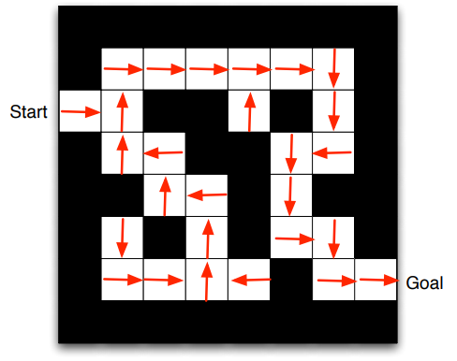
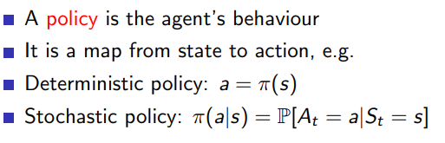
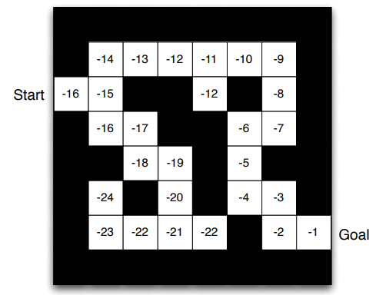
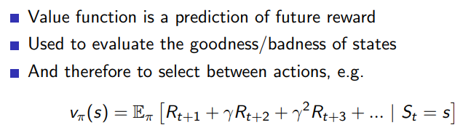
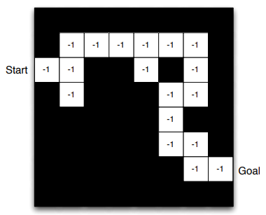
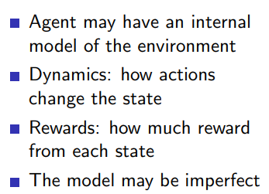
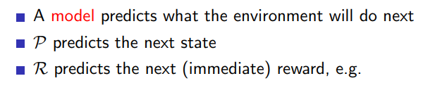

Inside An RL Agent
Policy
Value Function
Model

Slide 11
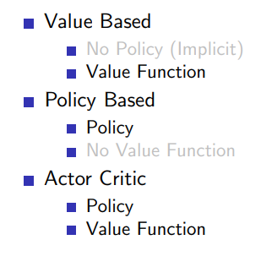
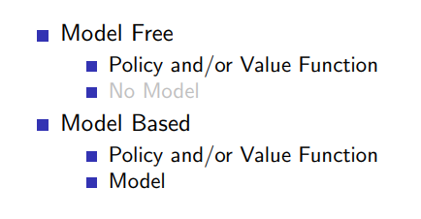
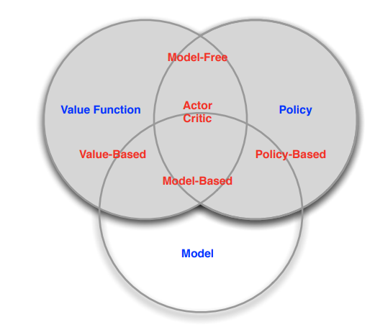
Categorizing RL agents

Slide 12
Markov Decision Processes
Markov Process
Markov Reward Processes
Markov Decision Processes
Extensions to MDPs

Slide 13

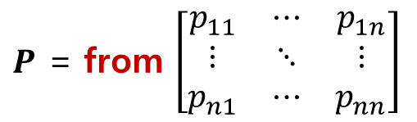

Markov Processes
Markov Property
Definition
A state $S_{t}$ is Markov if and only if
$P\left[S_{t+1}\right| S_{t}]$ = $P\left[S_{t+1}\right|S_{1}, …, S_{t}]$
The state captures all relevant information from the history
Once the state is known, the history may be thrown away
i.e. The state is a sufficient statistic of the future
State Transition Matrix
$$P_{ss′}[S_{t+1}=s′|S_{t}=s]$$
to
$P$ = from $\left[\begin{matrix}p_{11} & ⋯ & p_{1n} \\ ⋮ & ⋱ & ⋮ \\ p_{n1} & ⋯ & p_{nn}\end{matrix}\right]$
Each row of the matrix sums to 1

Slide 14
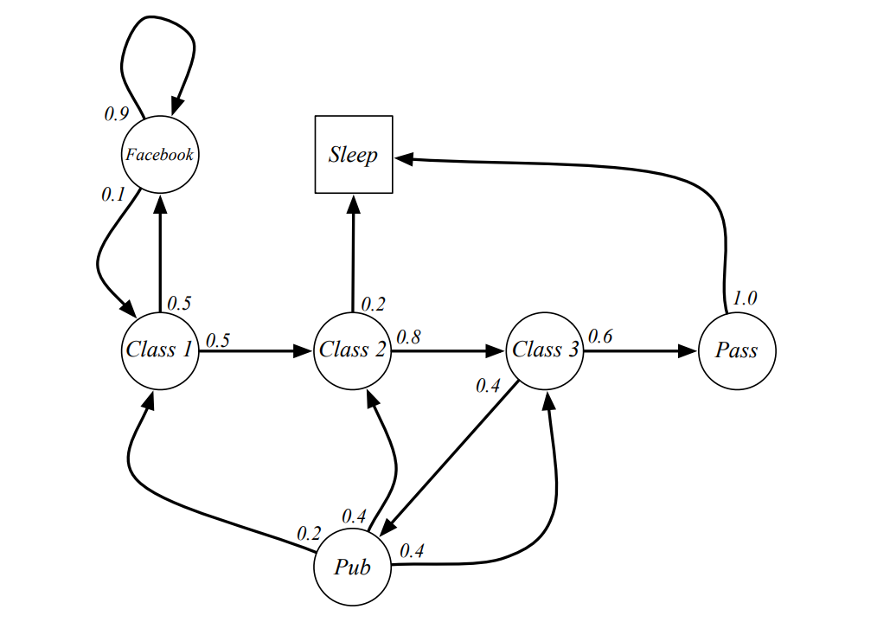
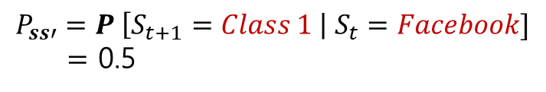
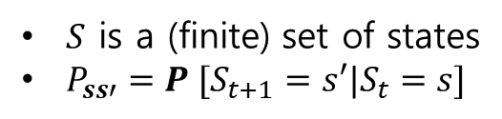

Markov Processes
Markov Process
Definition
A Markov Process(or Markov Chain) is a tuple <$S, P$>
$S$ is a (finite) set of states
$P_{ss′}=P [S_{t+1}=s′|S_{t}=s]$
Example
$$P_{ss′}=P \left[S_{t+1}=Class 1 \right| S_{t}=Facebook]$$
$=$ 0.5

Slide 15
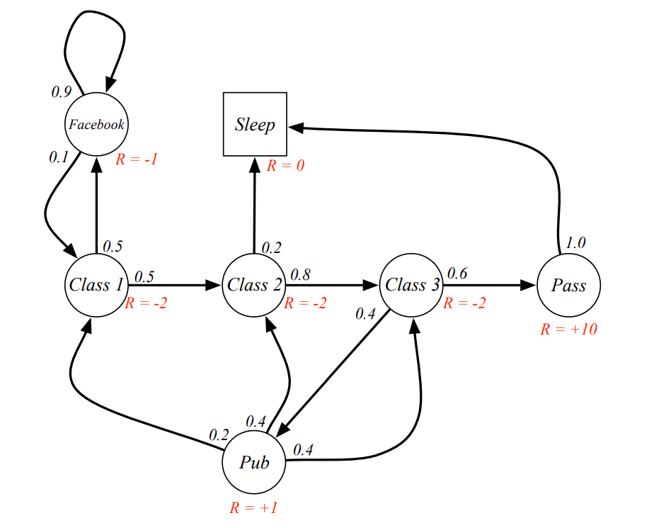
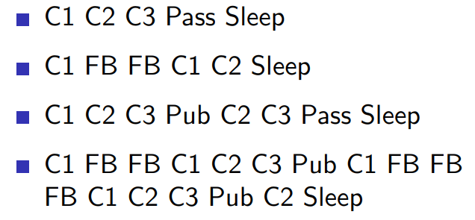
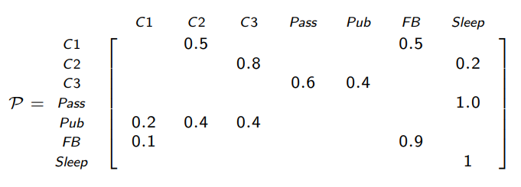
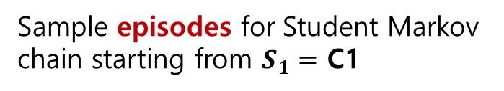
Markov Processes
Example : Student Markov Chain Episodes
end
Sample episodes for Student Markov chain starting from $S_{1}=$ C1
start
Transition Matrix

Slide 16
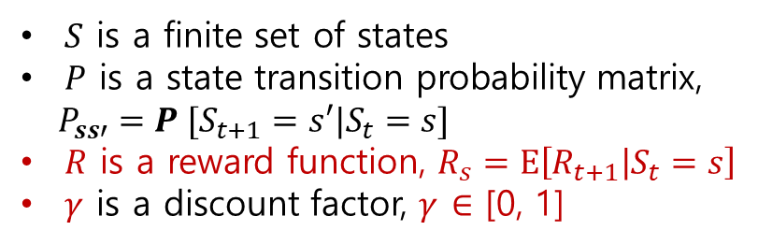

Markov Reward Processes
A Markov reward process is a Markov chain with values
Definition
A Markov Reward Process is a tuple <$S, P, R, γ$>
$S$ is a finite set of states
$P$ is a state transition probability matrix,
$P_{ss′}=P [S_{t+1}=s′|S_{t}=s]$
$R$ is a reward function, $R_{s}=\text{E}\left[R_{t+1} | S_{t}=s\right]$
$γ$ is a discount factor, $γ$ $∈$ [0, 1]

Slide 17

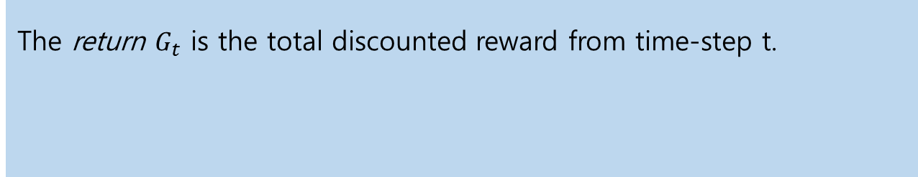

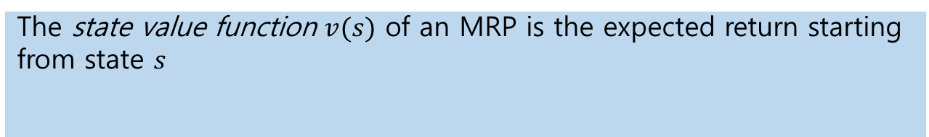
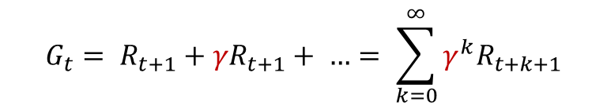
Markov Reward Processes
Return
Definition
The return $G_{t}$ is the total discounted reward from time-step t.
$$G_{t}= R_{t+1}+{γR}_{t+1}+ …= \sum_{k=0}^{∞}{γ^{k}R_{t+k+1}}$$
discount factor
$γ$ $∈$ [0, 1]
Value Function
Definition
The state value function $v(s)$ of an MRP is the expected return starting from state $s$
$v(s)=E$[$G_{t}$| $S_{t}=s$]
The value function gives $v(s)$ the long-term value of state $s$

Slide 18
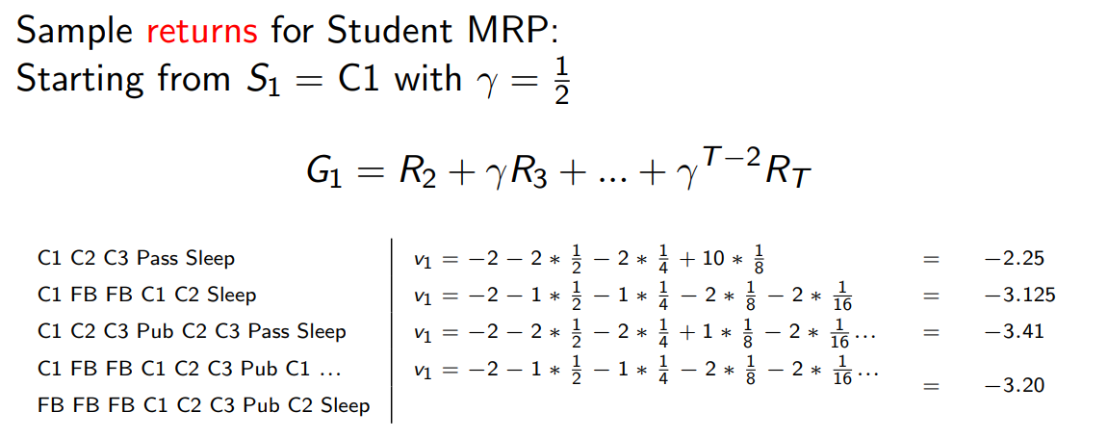
Markov Reward Processes
Returns
5
1
2
3
4

Slide 19
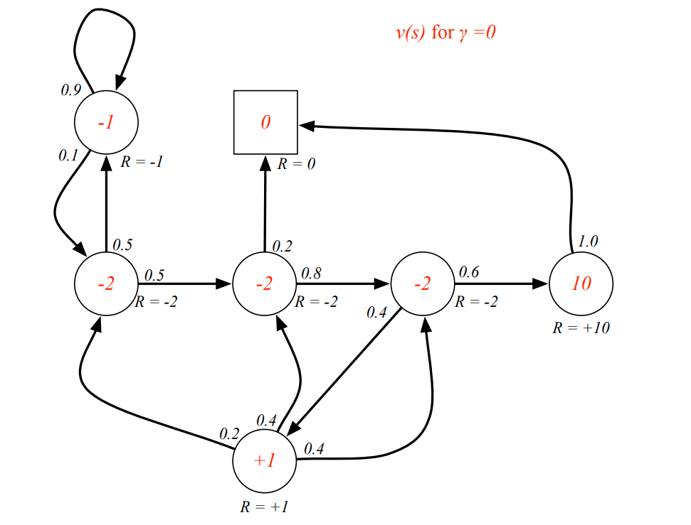
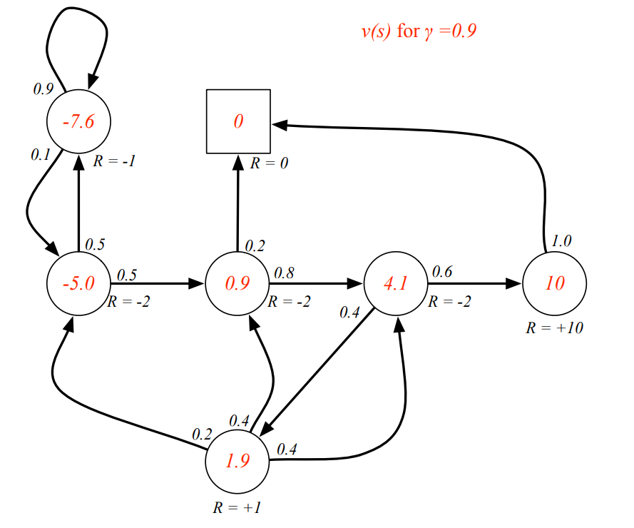
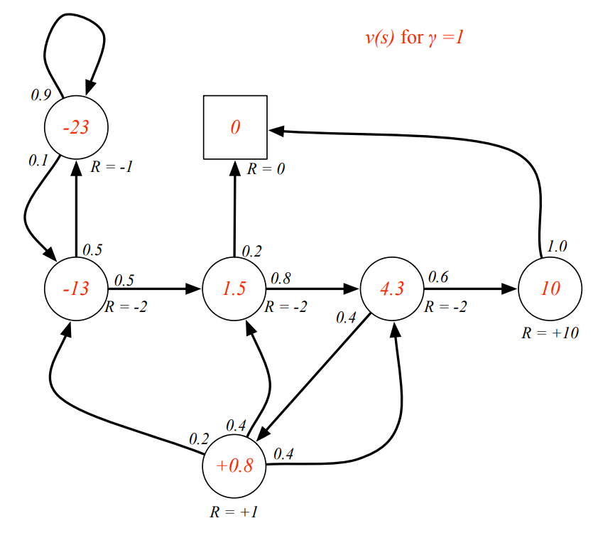
Markov Reward Processes
Example : Returns by $γ$

Slide 20
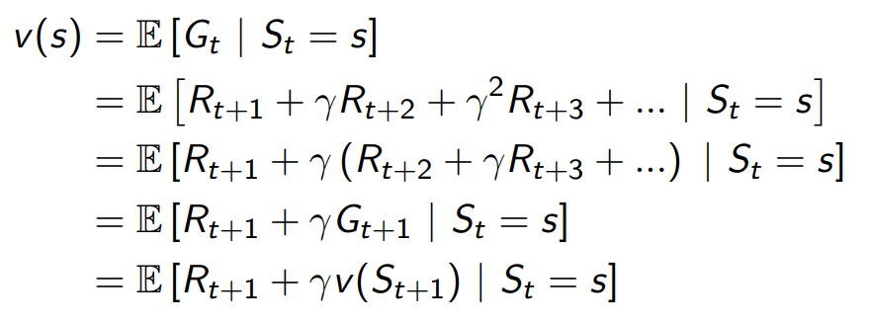
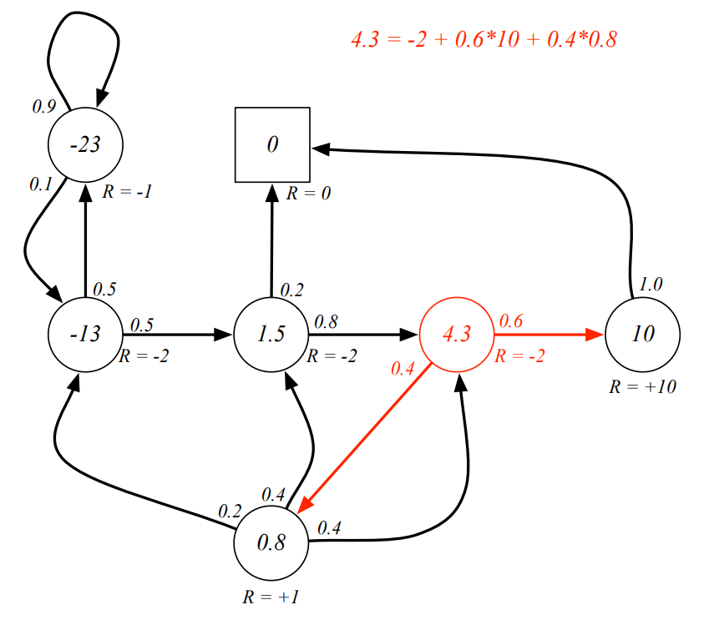
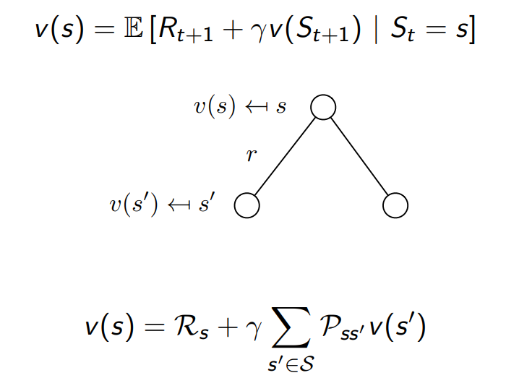
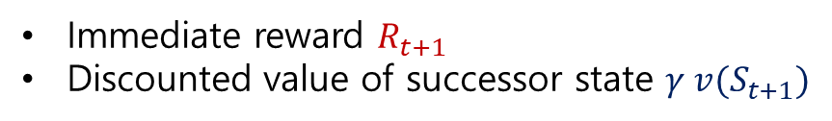
Markov Reward Processes
Bellman Equation for MRPs
The value function can be decomposes into two parts:
Immediate reward $R_{t+1}$
Discounted value of successor state $γ {v(S}_{t+1})$

Slide 21

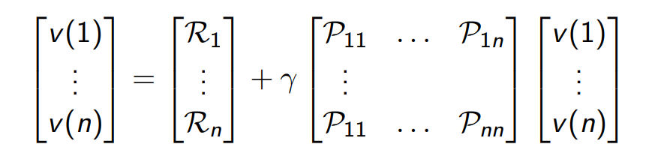
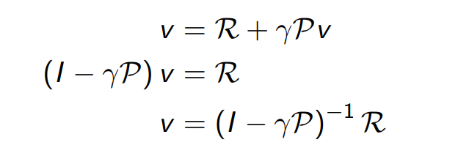

Markov Reward Processes
Bellman Equation in Matrix Form
Solving the Bellman Equation
Big O : O($n^{3}$)
Only small MRPs
There are many iterative methods for large MRPs, e.g.
Dynamic programming
Monte-Carlo evaluation
Temporal-Difference learning

Slide 22

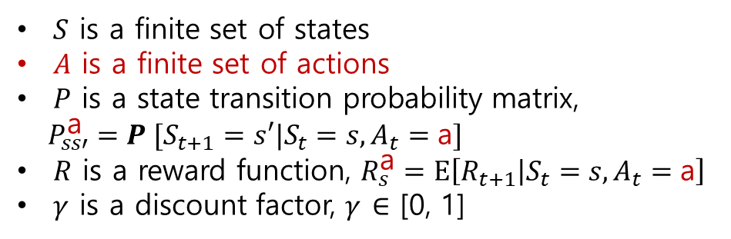
Markov Decision Processes
MDP is a MRP with decisions(actions).
Definition
A Markov Decision Process is a tuple <$S, A, P, R, γ$>
$S$ is a finite set of states
$A$ is a finite set of actions
$P$ is a state transition probability matrix,
$P_{ss′}^{\text{a}}=P [S_{t+1}=s′|S_{t}=s,A_{t}=\text{a}]$
$R$ is a reward function, $R_{s}^{\text{a}}=\text{E}\left[R_{t+1} | S_{t}=s,A_{t}=\text{a}\right]$
$γ$ is a discount factor, $γ$ $∈$ [0, 1]

Slide 23
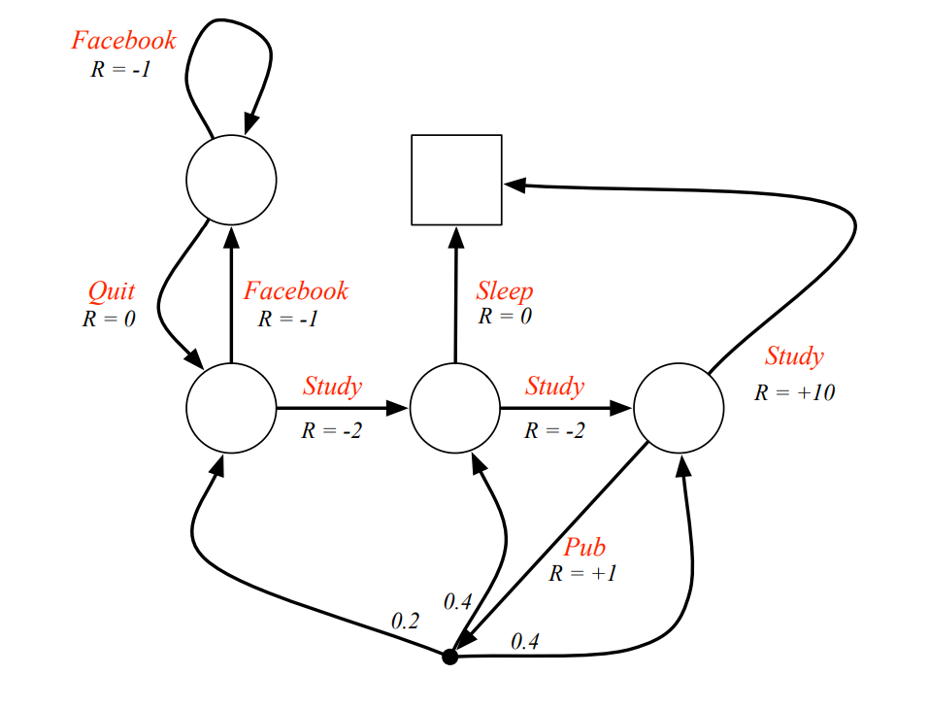
Markov Decision Processes
Example : Student MDP

Slide 24
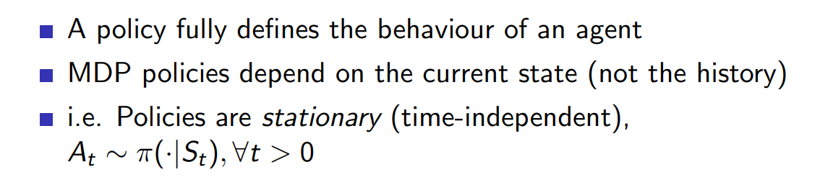
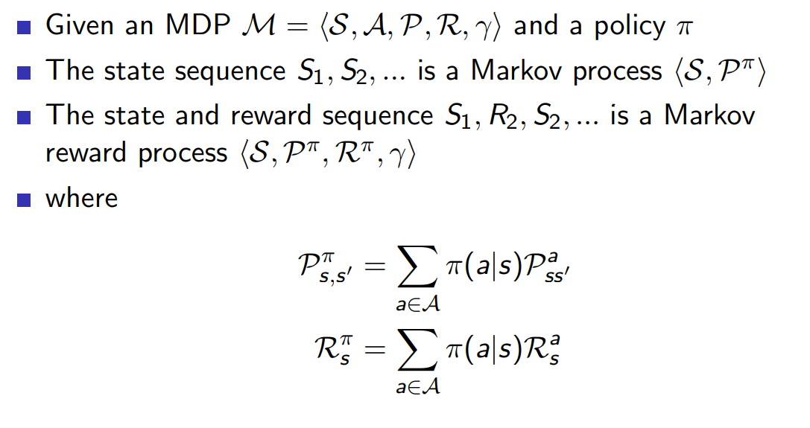


Markov Decision Processes
Policy
Definition
A Policy $π$ is a distribution over actions given states,
$π(\text{a}|s)=P$[$A_{t}=\text{a}$| $S_{t}=s$]

Slide 25
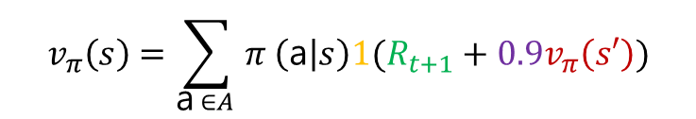


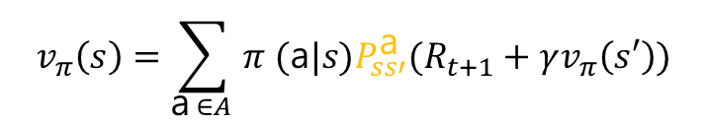
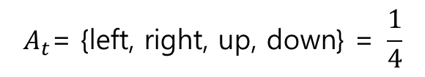
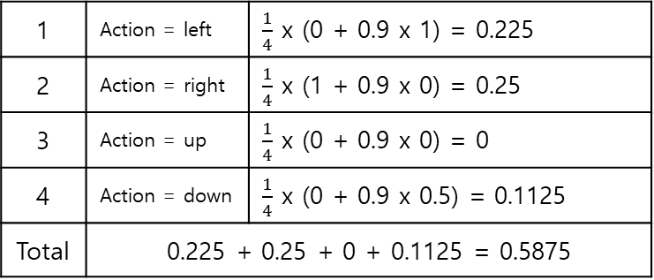
Markov Decision Processes
Example
 | v=0
v=1 | A | v=0
 | v=0.5 | ★ (1)
If the current(A) value-function is 0,
Let's get it through the bellman equation
$$v_{π}\left(s\right)=\sum_{\text{a} ∈A }{π (\text{a}|s)P_{ss′}^{\text{a}}(R_{t+1}+γv_{π}\left(s′\right))}$$
$$v_{π}\left(s\right)=\sum_{\text{a} ∈A }{π \left(\text{a} | s\right)1(R_{t+1}+0.9v_{π}\left(s′\right))}$$
$π(\text{a}|s)=P$[$A_{t}=\text{a}$| $S_{t}=s$]
$$A_{t}\text{= \{}\text{left}\text{, }\text{right}\text{, }\text{up}\text{, }\text{down}\text{\} = }\frac{1}{4}$$
$$P_{ss′}^{\text{a}}=P \left[S_{t+1}=s^{′} | S_{t}=s,A_{t}=\text{a}\right]=1$$
1 | Action = left | $\frac{1}{4}$ x (0 + 0.9 x 1) = 0.225
2 | Action = right | $\frac{1}{4}$ x (1 + 0.9 x 0) = 0.25
3 | Action = up | $\frac{1}{4}$ x (0 + 0.9 x 0) = 0
4 | Action = down | $\frac{1}{4}$ x (0 + 0.9 x 0.5) = 0.1125
Total | 0.225 + 0.25 + 0 + 0.1125 = 0.5875
$γ$ = 0.9

Slide 26




Markov Decision Processes
Value function
Definition
The state-value function $v_{π}(s)$ of an MDP is the expected return starting from state $s$, and then following policy $π$
$v_{π}(s)=E_{π}$[$G_{t}$| $S_{t}=s$]
Q-function (action-value function)
Definition
The action-value function $q_{π}(s)$ is the expected return starting from state $s$, taking action $\text{a}$, and then following policy $π$
$q_{π}(s,\text{a})=E_{π}$[$G_{t}$| $S_{t}=s,A_{t}=\text{a}$]

Slide 27

Markov Decision Processes
Example : State-Value Function for Student MDP

Slide 28

Markov Decision Processes
Bellman Expectation Equation
The state-value function
$v_{π}(s)=E_{π}$[$R_{t+1}+γv_{π}(S_{t+1})$| $S_{t}=s$]
The action-value function
$q_{π}(s,\text{a})=E_{π}$[$R_{t+1}+γq_{π}(S_{t+1},A_{t+1})$| $S_{t}=s,A_{t}=\text{a}$]

Slide 29




Markov Decision Processes
Bellman Expectation Equation for $V^{π}$
①
③
Bellman Expectation Equation for $Q^{π}$
②
④
next

Slide 30


Markov Decision Processes
Example : State-Value Function for Student MDP
= $\frac{1}{2}∗$(10 + 1*[0]) + $\frac{1}{2}∗$(1 + 1*[0.2*(-1.3) + 0.4*(2.7) + 0.4*(7.4)])

Slide 31

Markov Decision Processes
Bellman Expectation Equation (Matrix Form)

Slide 32



Markov Decision Processes
Optimal Value Function
Definition
The optimal state-value function $v_{∗}(s)$ is the maximum value function over all policies
The optimal action-value function $q_{∗}(s,\text{a})$ is the maximum action-value function over all policies
$$v_{∗}\left(s\right)=\max_{π}{v_{π}(s)}$$
$$q_{∗}\left(s,\text{a}\right)=\max_{π}{q_{π}(s,\text{a})}$$

Slide 33

Markov Decision Processes
Example : Optimal Value Function for Student MDP

Slide 34



Markov Decision Processes
Example : Optimal Action-Value Function for Student MDP

Slide 35


Markov Decision Processes
Optimal Policy
증명은 생략…
Finding an Optimal Policy

Slide 36

Markov Decision Processes
Example: Optimal Policy for Student MDP

Slide 37




Markov Decision Processes
Bellman Expectation Equation for $V_{∗}$
①
③
Bellman Expectation Equation for$Q_{∗}$
②
④

Slide 38

Markov Decision Processes
Example: Bellman Optimality Equation in Student MDP

Slide 39
Markov Decision Processes
Solving the Bellman Optimality Equation
Bellman Optimality Equation is non-linear
No closed form solution (in general)
Many iterative solution methods
Value Iteration
Policy Iteration
Q-learning
Sarsa

